Slide 1
A Mental Health-Friendly Workplace
Mental Wellness Training Module
for Creating Workplaces that THRIVE
Citation: Substance Abuse and Mental Health Services Administration. Workplaces that Thrive: A resource for Creating Mental Health-Friendly Work Environments. SAMHSA Pub. No. P040478M. Rockville, MD: Center for Mental Health Services, Substance Abuse and Mental Health Services Administration, 2004

Slide 2

GOAL & OBJECTIVES
Continue the process of creating a more mental health friendly work environment.
You will learn:
  Mental illness is common
  There are effective treatments and people recover
  How your workplace will benefit from mental health friendly policies and practices
  What a mental health friendly workplace is and does

Slide 3

Mental illness is common
Affects 17 million Americans in any given year
    28 million in the workforce
    #1 alcohol abuse/dependence
    #2 major depression
    #3 social phobia/anxiety disorder
    38% experience two within one year
What is mental illness?
    Conditions that involve thinking, mood and behavior

Slide 4
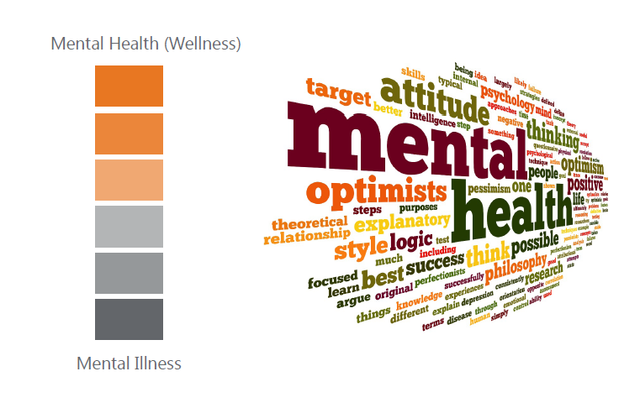
CONTINUUM

Slide 5
The Good News
Mental illnesses are treatable.
Treatments, medications and other strategies are available.
People with mental illnesses recover and go on to live normal and productive lives.

Slide 6
Why is this important in the workplace?
Work is integral to one’s self worth.
Finding and belonging to a mental health friendly workplace is of great significance to people who have experienced mental illness.

Slide 7
Why Many DO NOT seek treatment
  Cost
  Fear
  Not knowing where to go for services
  Concern about confidentiality
  Opinions of neighbors, employers, co-workers and their community

Slide 8
STIGMA: An AURA of shame and blame
A barrier to well being and a full life
Holds applicants back
Deters one from seeking help
Causes discomfort for returning employees

Slide 9

Having a Mental Health-Friendly Workplace
Caring about policies and practices bring:
  Higher productivity and motivation
  Reduced absenteeism
  Health insurance cost containment
  Loyalty and retention
  Diversity, acceptance, and respect in the workplace

Slide 10
HANDOUT on Common Mental Illness
Anxiety disorder
  Panic disorders
  Obsessive compulsive disorders
  PTS
  Generalized anxiety disorder
  Social anxiety disorder
  ADHD
Depressive disorders
Eating Disorders
Shizophrenia

Slide 11
More Handouts
A Mental Health Friendly Workplace
What Can We Do to Counter Stigma
Myths and Facts About Mental Illness
National Resources

Slide 12
As a Manager or Supervisor
What you can do to have
a workplace that thrives!

Slide 13
Know Your Policy and Practices
Understand employee assistance resources and publicize them
Be open to making reasonable accommodation
Be aware of The Americans with Disabilities Act

Slide 14
The ADA protects those with disability
1
Has a mental or physical impairment that substantially limits one or more of his/her major life activities
2
Has a record of such an impairment
Is regarded as having such an impairment
3
The definition of disability should be construed in favor of broad coverage…and generally shall not require extensive analysis.
… requires reasonable accommodation

Slide 15

Reasonable accommodation
Schedule modifications
Job modification
Modifications in physical environment
Changes in policy
Provision of human assistance
Provisions of assistive technology
Supervisory techniques

Slide 16
What can a supervisor do?
Do not try to diagnose a problem by yourself
Learn about mental illness and sources of help
Recognize behavior that signals distress

Slide 17

Behaviors that signal distress
Displays of anger or blaming others
Safety risks and accidents
Frequent absenteeism
Consistent tardiness
Frequent statements about being tired
Decreased productivity
Morale problems

Slide 18
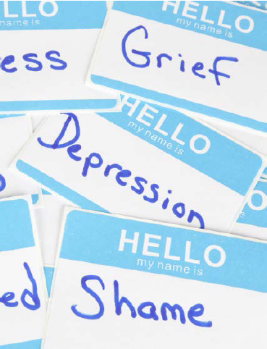
Behaviors that signal distress
Difficulty concentrating, making decisions, or remembering things
Working excessive overtime over a prolonged period
Complains of unexplained aches and pains
Lack of cooperation or a general inability to work with others
Strange or grandiose ideas
Alcohol or drug abuse

Slide 19
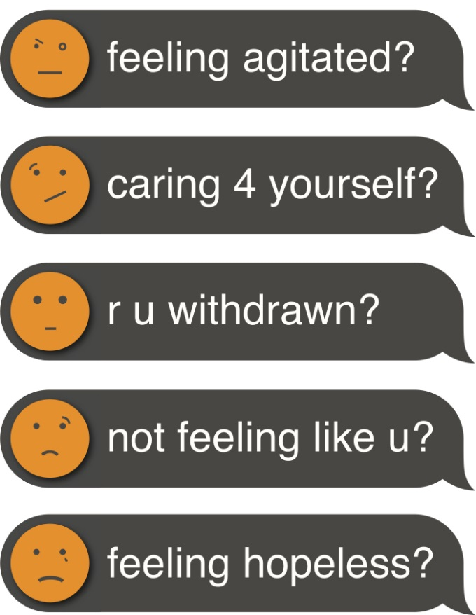
The Campaign to Change Direction
Learn the 5 signs

Slide 20
What else can a manager do?
Use your skills to make the workplace feel safe and comfortable for ALL employees
Discuss changes in work performance with the employee
MAINTAIN CONFIDENTIALITY
Become familiar with the resources available for assisting employees
Recognize that an employee who is experiencing mental illness or distress may need a flexible schedule during treatment

Slide 21
Suggestions on how to start the conversation
“You’ve always been such a reliable staff person—top quality work done on schedule and within budget. But I’m concerned that recently you’ve been late to work often and are not meeting your performance objectives. I’d really like to see you get back on track. Is there anything that you can think of that would help you get back on track? Is there anything I can do to help?”
“Suzie, I see that you seem sad and it is affecting your work by not meeting your deadlines. From time to time, it is natural for everyone to get down, and many times it helps having someone to talk with.” (Then offer resources and follow up)

Slide 22
Suggestions on how to start the conversation
”Let’s get together 3 weeks from now, and talk again. We can see how the work is going, and whether any changes need to be made.”
“I don’t know whether this is the case for you, but if personal issues are affecting your work, you can speak confidentially to one of our employee assistance counselors. The service was set up to help employees. You can discuss with the counselor whether you might need any accommodations. Our conversation today, and appointments with the counselor, will be kept confidential and will not affect your job. . .”

Slide 23
Common Resources for Employees
Great Rivers 2-1-1
Primary Care Providers
Behavioral Health Specialists
Employee Assistance Programs (EAP)
Urgent Care/Emergency Room Staff
Family members, friends, teachers, colleagues, pastors can be valuable resources too

Slide 24
Discussion and questions

